Slide 1
Data Model PowerPivot
and
Dashboards

Slide 2
Objectives
Understand the basics of dashboard design
Explore the new data model
Create advanced data models using PowerPivot
Create PivotTables and PivotCharts with PowerPivot

Slide 3
Objectives
Use Apps for Office for data visualizations
Prepare a dashboard for production
Generate visual reports with Power View

Slide 4
Understand the Basics of Dashboard Design
Business intelligence (BI)–software applications used to analyze organization’s data for management decision making
Digital dashboards–deliver BI in graphical format

Slide 5
Understand the Basics of Dashboard Design
Dashboard:
Single screen
Visually oriented
Intuitive, easy to navigate
Interactive controls for customization
Integration of multiple data types
Data frequently updated
Information oriented around specific problem
Extra training should not be there

Slide 6
Understand the Basics of Dashboard Design
Keep it simple
Make sure it is well defined
Know your users
Define key performance indicators (KPI)
Use strategic placement
Design with white space

Slide 7
What is Power Pivot & why is it useful?
Although an Excel worksheet can handle 1,048,576 rows of data. In reality, it can struggle as you get to 100,000 or even before that depending on what you have in your workbook.
Power Pivot enables us to work with big data beyond the 1,048,576 limitation and still produce smaller, leaner and faster workbooks than a standard PivotTable.
It does this by loading the data into the internal data model of Excel and not onto a worksheet. Relationships can then be created between the different tables of data. No more VLOOKUPs to pull data together into one big list.
We can then create PivotTables based on this model to analyze multiple tables of data.
You can also use a powerful formula language in Power Pivot called DAX. This stands for Data Analysis Expressions.
The DAX language is vast and enables us to perform more complex calculations than we can do with a standard PivotTable.
So what is Power Pivot?
It is really a combination of using PivotTables and DAX calculations with the internal data model of Excel for analysis of big data.

Slide 8
Power Pivot
Powerpivot self – service business intelligence
There is no limitation for rows and columns
One can integrate data multiple source
Data in powerpivot fully available to rest of excel workbook
Power pivot also allow you to perform same function as of excel workbook but powerpivot is a combination of pivot table and complex function(DAX language)

Slide 9
Explore the New Data Model
Data model–collection of tables and relationships
Relational data–data about person, place, or thing stored in multiple tables
Sources:
Access database
SQL Server
Text file
SharePoint list

Slide 10
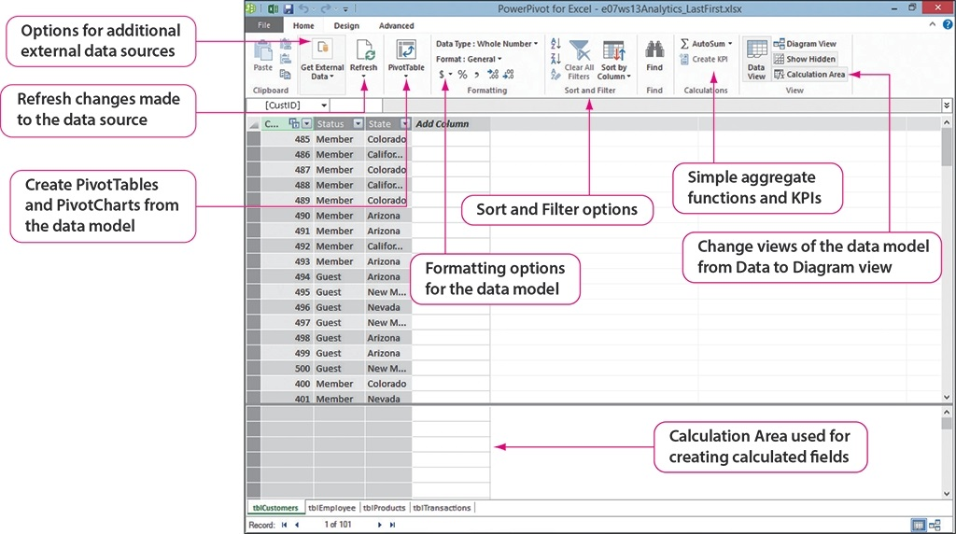
Explore the New Data Model

Slide 11
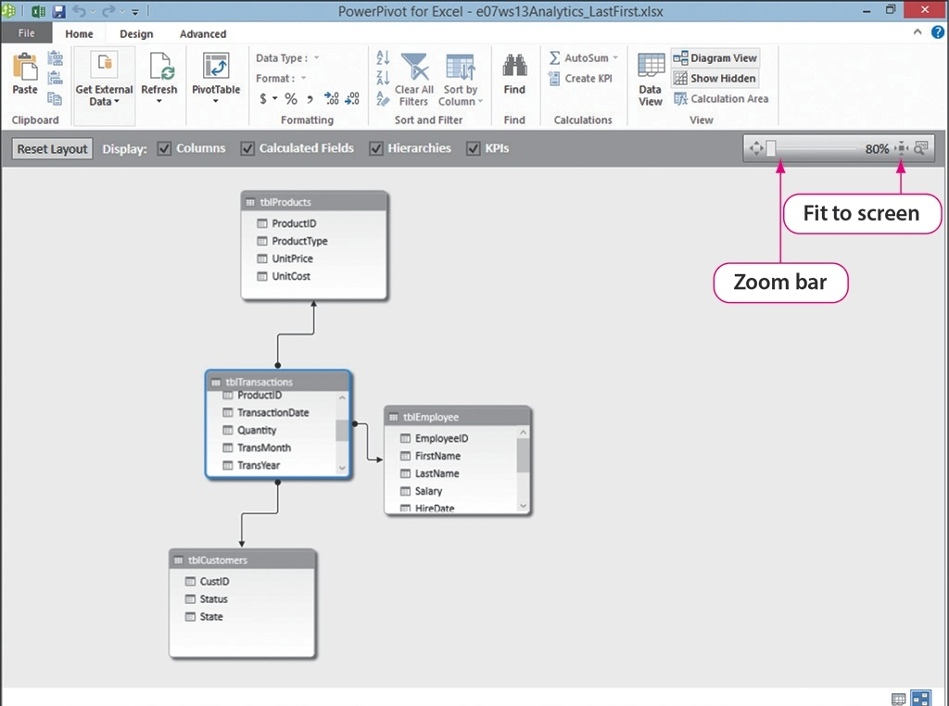
Explore the New Data Model

Slide 12
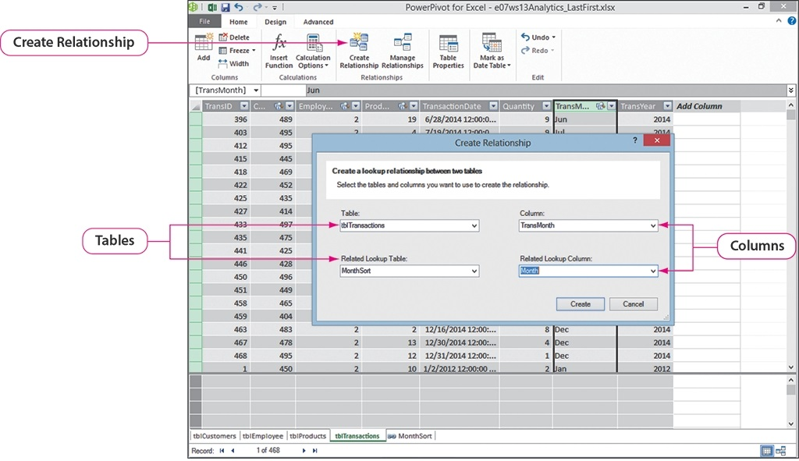
Create Advanced Data Models Using PowerPivot

Slide 13
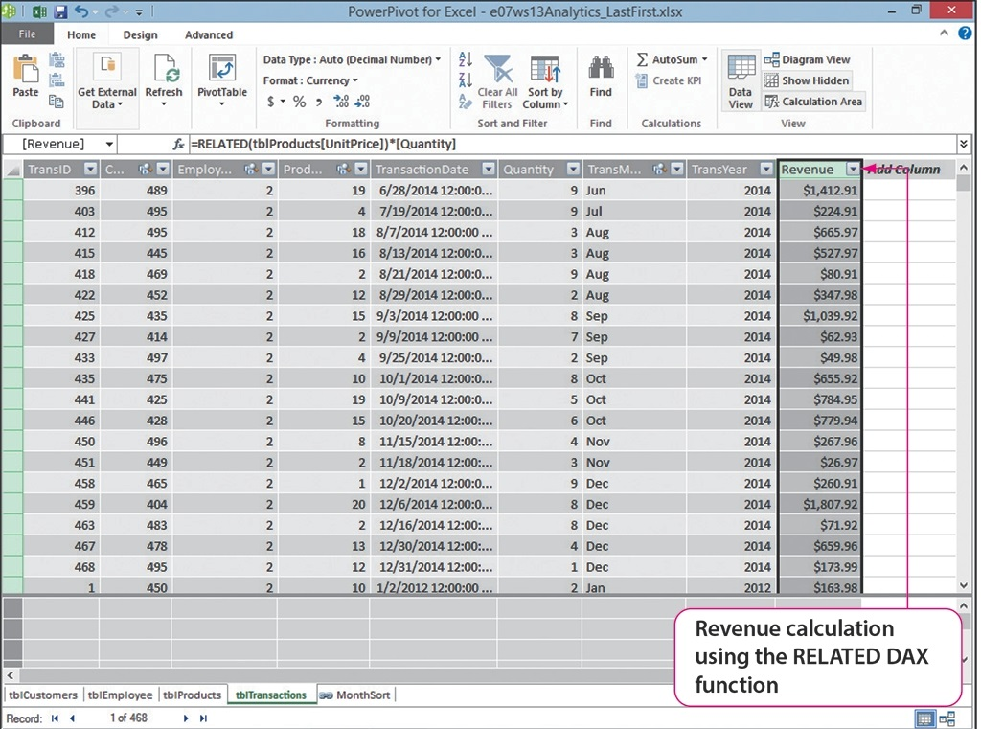
Create Advanced Data Models Using PowerPivot
=RELATED(tblProducts[UnitPrice])*[Quantity]

Slide 14
Create Advanced Data Models Using PowerPivot
Calculated fields:
Implicit calculated field
Drag field into Values area
Functions: AVERAGE, SUM, COUNT, MAX
New field not created
Explicit calculated field
Formula typed in Calculation area
Wide variety of functions available

Slide 15
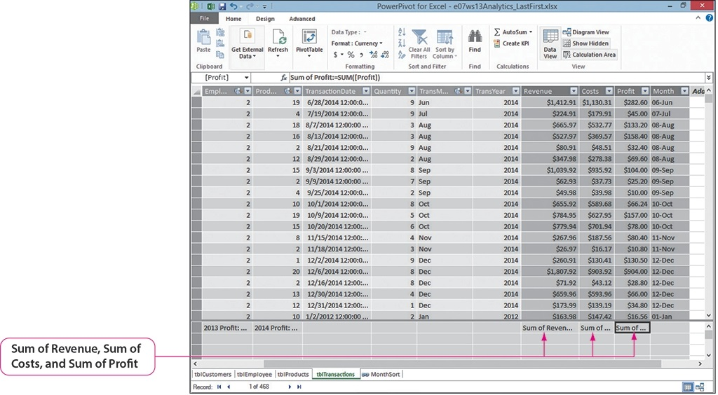
Create Advanced Data Models Using PowerPivot

Slide 16
Create Advanced Data Models Using PowerPivot
Key performance indicators:
Base value
Target value
Status threshold
Positive KPI
Negative KPI
Bidirectional KPI

Slide 17
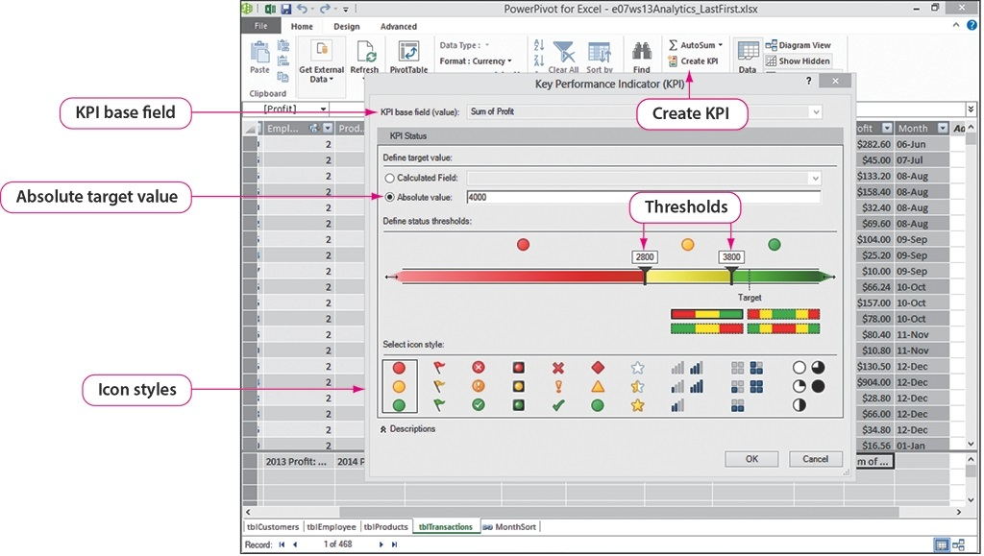
Create Advanced Data Models Using PowerPivot

Slide 18
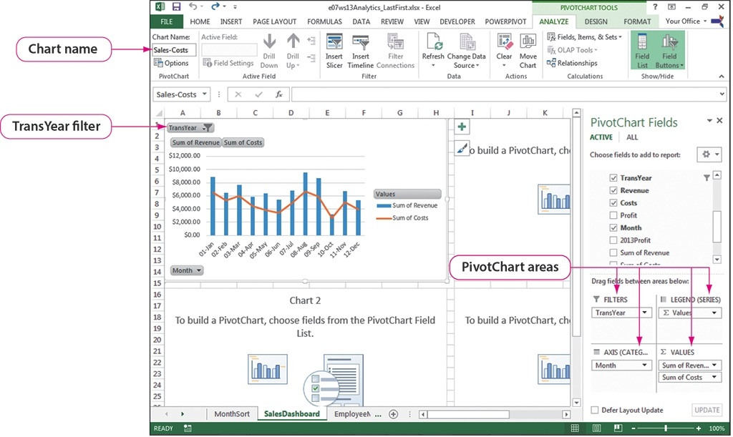
Create PivotTables and PivotCharts with PowerPivot

Slide 19
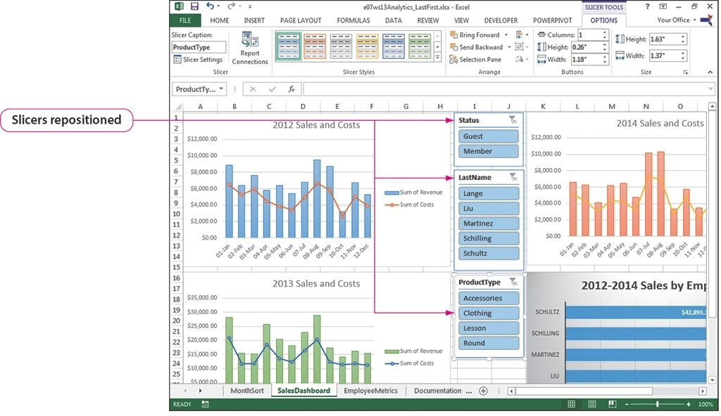
Create PivotTables and PivotCharts with PowerPivot

Slide 20
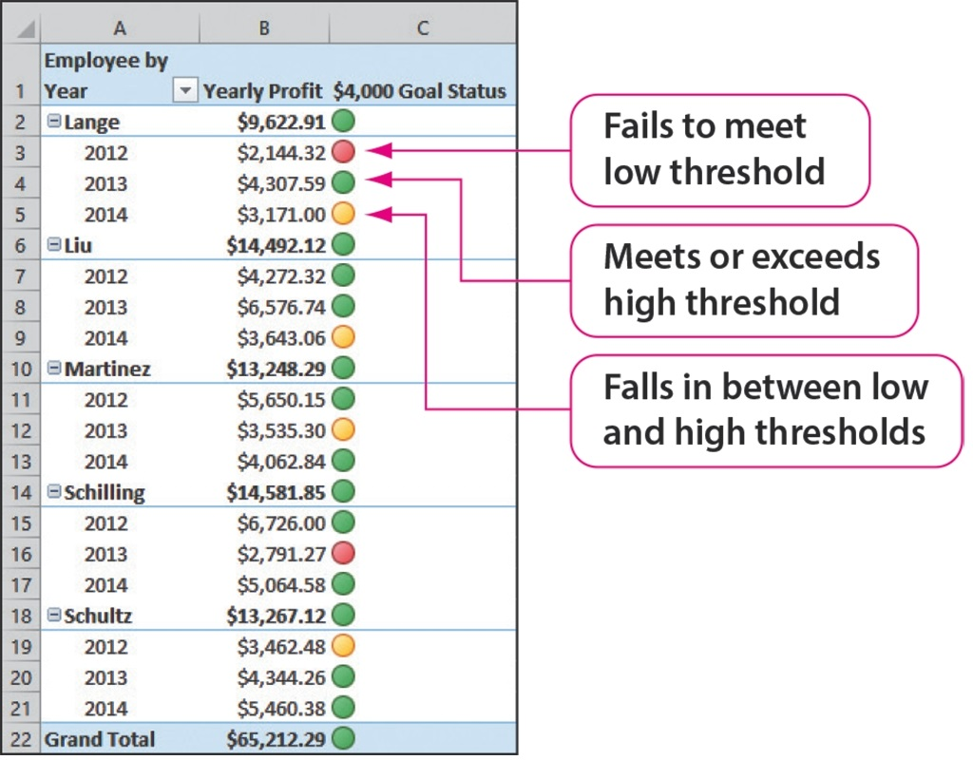
Create PivotTables and PivotCharts with PowerPivot

Slide 21
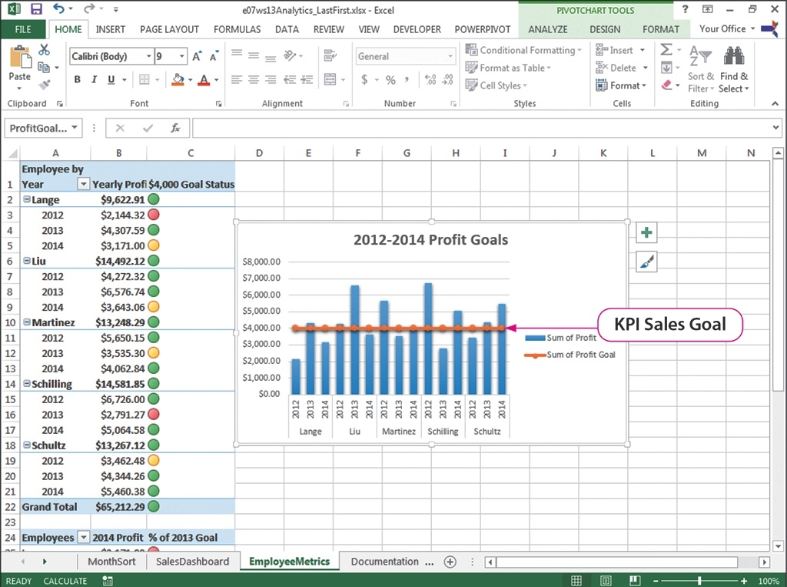
Create PivotTables and PivotCharts with PowerPivot

Slide 22
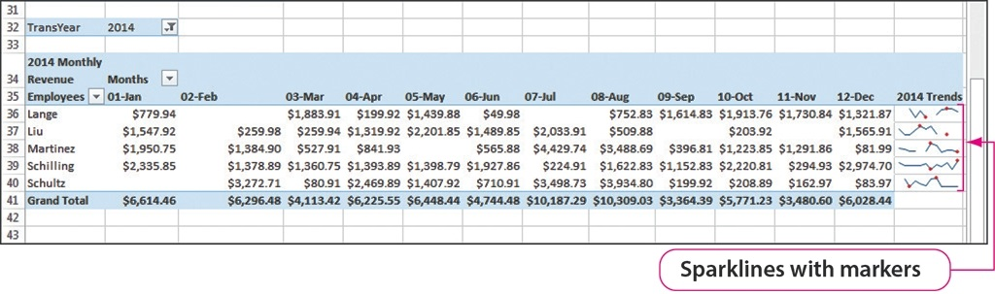
Create PivotTables and PivotCharts with PowerPivot

Slide 23
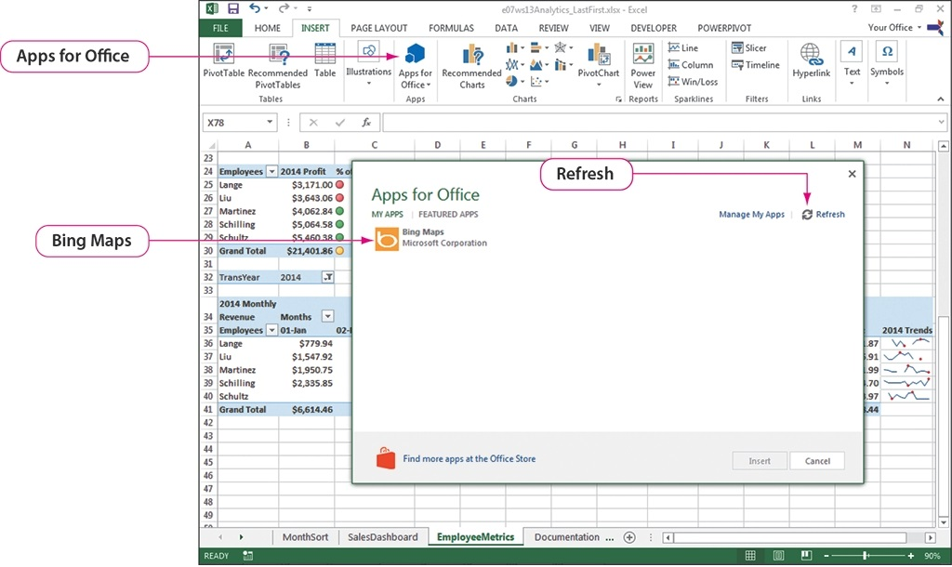
Use Apps for Office for Data Visualizations

Slide 24
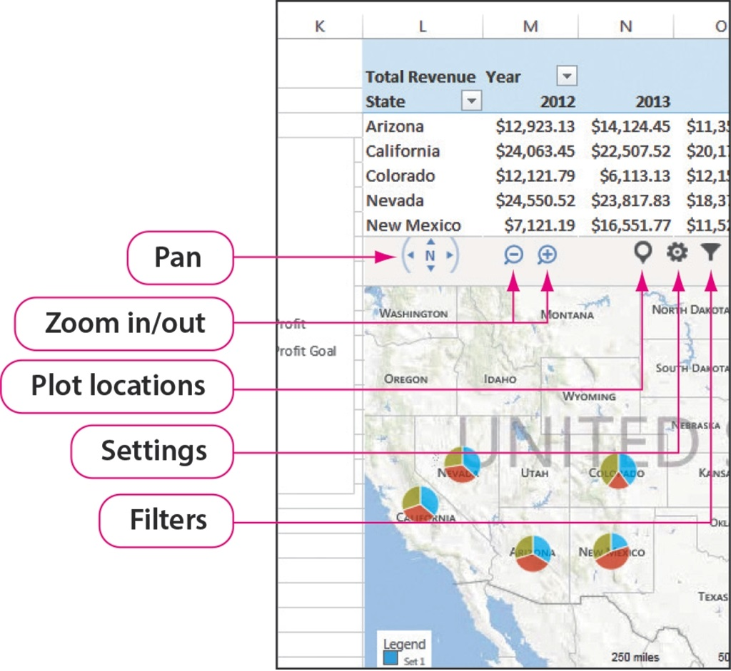
Use Apps for Office for Data Visualizations

Slide 25
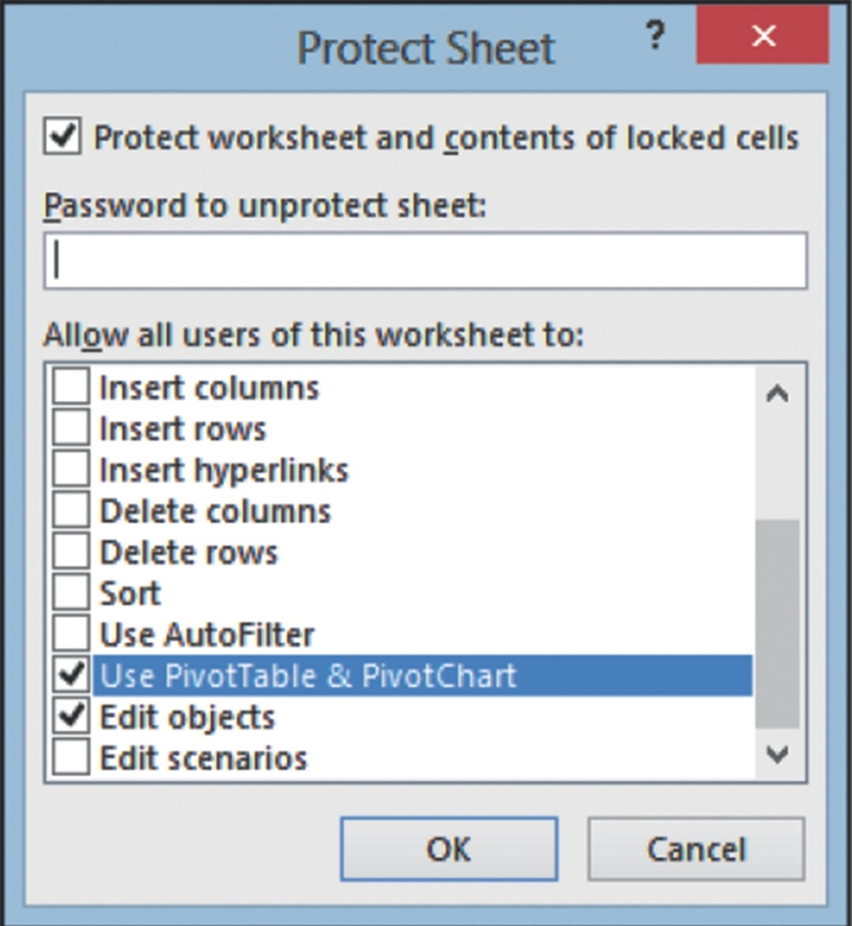
Prepare a Dashboard for Production

Slide 26
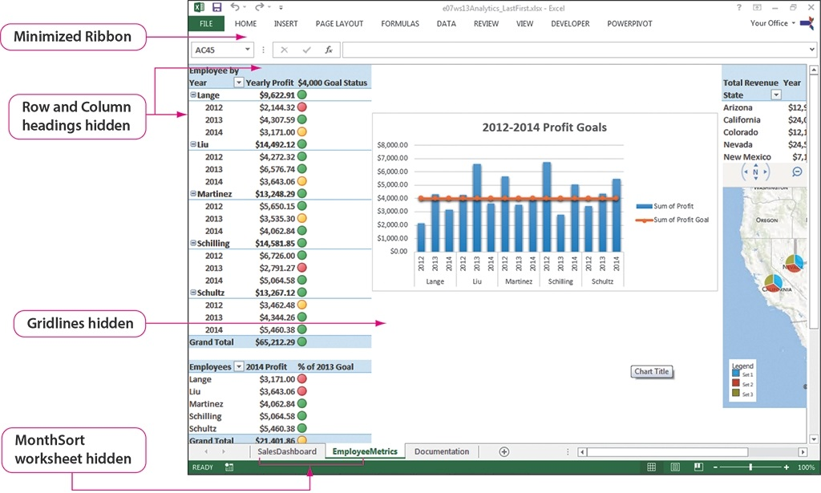
Prepare a Dashboard for Production

Slide 27
Generate Visual Reports with Power View
Power View:
Data visualizations
Tables
Charts
Maps
And more
Refresh and filter data
Slicers
Microsoft Silverlight–free plug-in

Slide 28
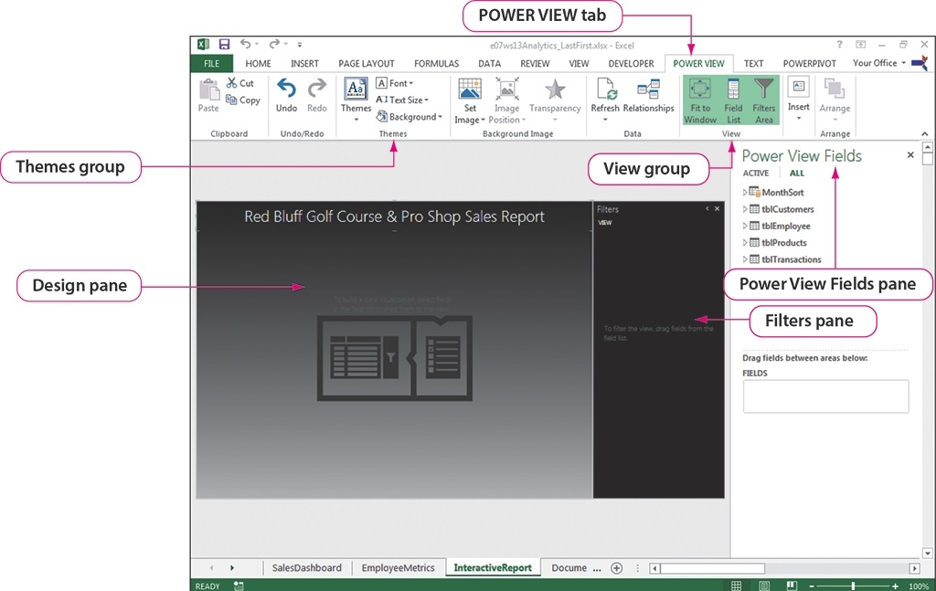
Generate Visual Reports with Power View

Slide 29
Generate Visual Reports with Power View
Multiples:
Identical charts
Same x- and y-axes
Different values
Vertical multiples–width of container, wrap down, can add scroll bar
Horizontal multiples–width of container, adds scroll bar if needed

Slide 30
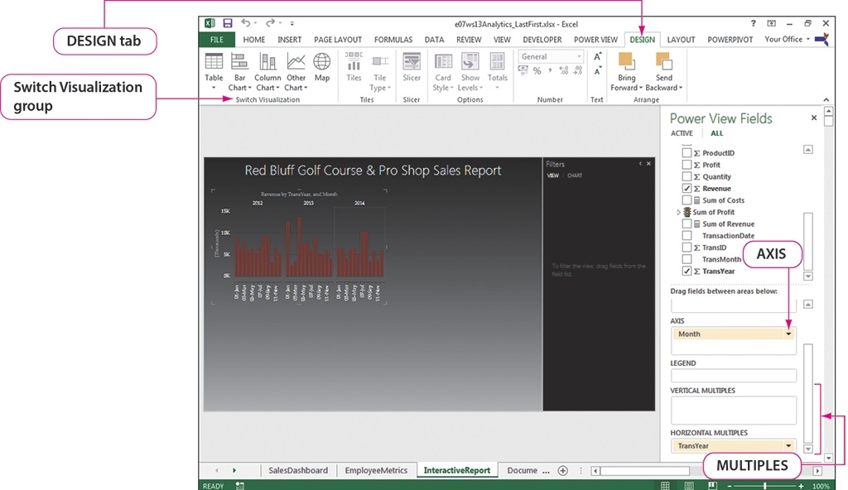
Generate Visual Reports with Power View

Slide 31
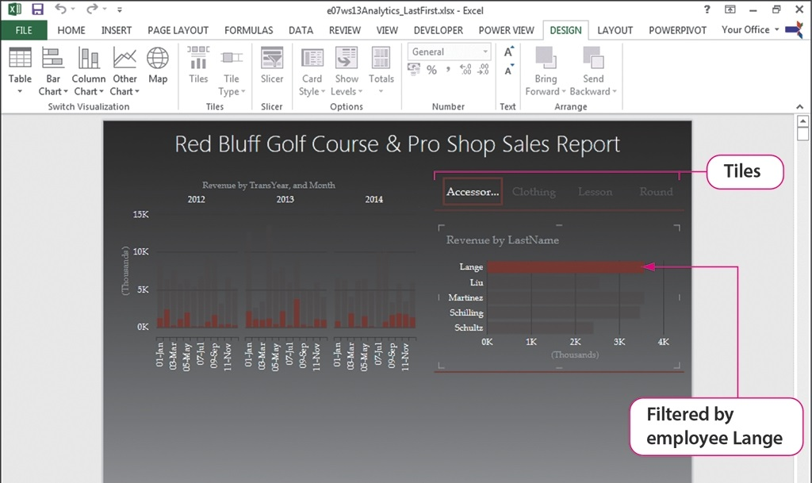
Generate Visual Reports with Power View

Slide 32
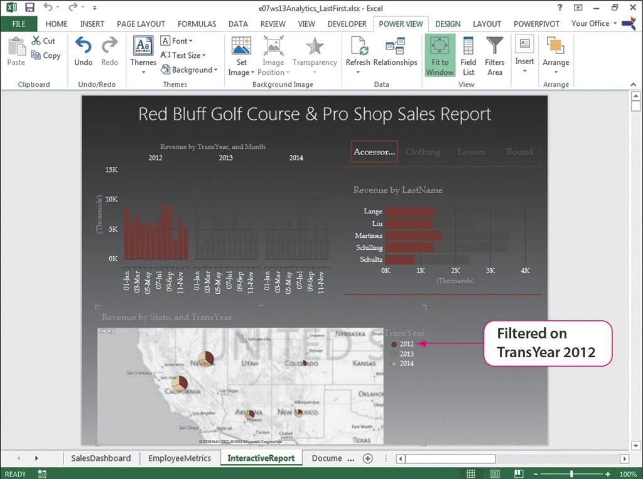
Generate Visual Reports with Power View

Slide 33
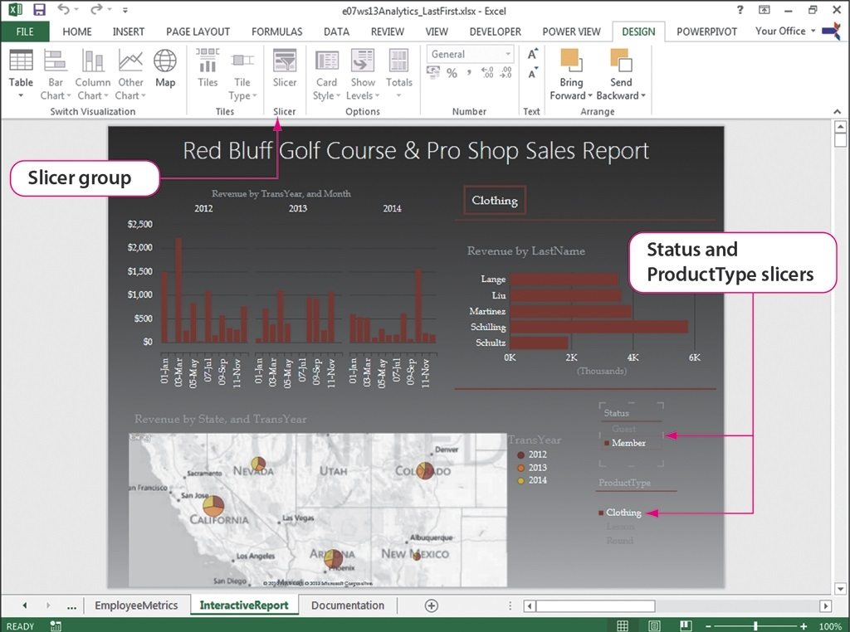
Generate Visual Reports with Power View

